Slide 1

NEXT STEP UNI: (for the next big step in education)
A website that can help the youth to choose a best college
Vaishnavi Bhola
Sharanya Nadyal

Slide 2
Problem Statement
Students often struggle to find suitable courses and universities due to scattered and unorganized information across multiple sources. Existing platforms may not provide personalized filters, up-to-date details, or easy comparisons. This lack of centralized and reliable guidance leads to confusion and missed opportunities. A Course and University Finder website can solve this by offering a one-stop platform for searching, comparing, and selecting the best-fit academic options.

Slide 3
Features of this website
Search & Filter Options – Users can search courses/universities by country, fees, duration, or field of study.
Course & University Details – Display comprehensive information like eligibility, syllabus, rankings, and admission requirements.
Comparison Tool – Allow users to compare multiple courses or universities side by side.
Personalized Recommendations – Suggest suitable programs based on user preferences or academic background.
Application Guidance – Provide step-by-step admission process details, deadlines, and required documents.
Save & Bookmark – Enable users to save favorite courses/universities for easy access later.
Intuitive UI – user friendly design with quick look sidebars or summaries to give brief course overviews without cluttering pages.

Slide 4
what’s new
“our website is newly created, focusing on simplicity and effectiveness to ensure users
quickly find what they need”
Our website is designed to be highly user-friendly, providing an intuitive experience for all visitors.
Our website stands out because it is consistently updated with the latest, accurate data, ensuring students have access to the most current information for making informed decisions.
This clearly communicates both ease of use and the unique value proposition of your updated
Natural Language Processing (NLP) Chatbots: AI chatbots can interact with users in real-time, answering queries, guiding them through course selection, and helping with application processes, improving user engagement.

Slide 5
How our platform is dynamically updated with fresh and relevant content : Surveys: Surveys are frequently used for collecting standardized data from students, staff, and alumni regarding experiences, attitudes, and outcomes. Interviews and Focus Groups: These methods provide deeper insight into individual or group perspectives, allowing institutions to understand context and opinions beyond survey data. Student Information Systems (SIS): SIS platforms aggregate a wide range of student records, from academic progress to demographic.

Slide 6
Data Collection Methods
Method | Type | Example Tools/Systems | Key Benefits | Use Case
Survey | Quantitative | Google Forms, SIS | Cost effective, scalable | Student satisfaction survey
Interview/Focus Group | Qualitative | In-person/online | Deep insights, context | Institutional reviews
Observation/Document Review | Qualitative | Manual, LMS | Contextual, detailed | Event or program evaluation
Student Information Systems | Administrative | SIS, LMS | Real-time, integrated data | Student records, performance
Official Data Reports | Secondary | IPEDS, AISHE | National benchmarking | Enrollment, demographics

Slide 7
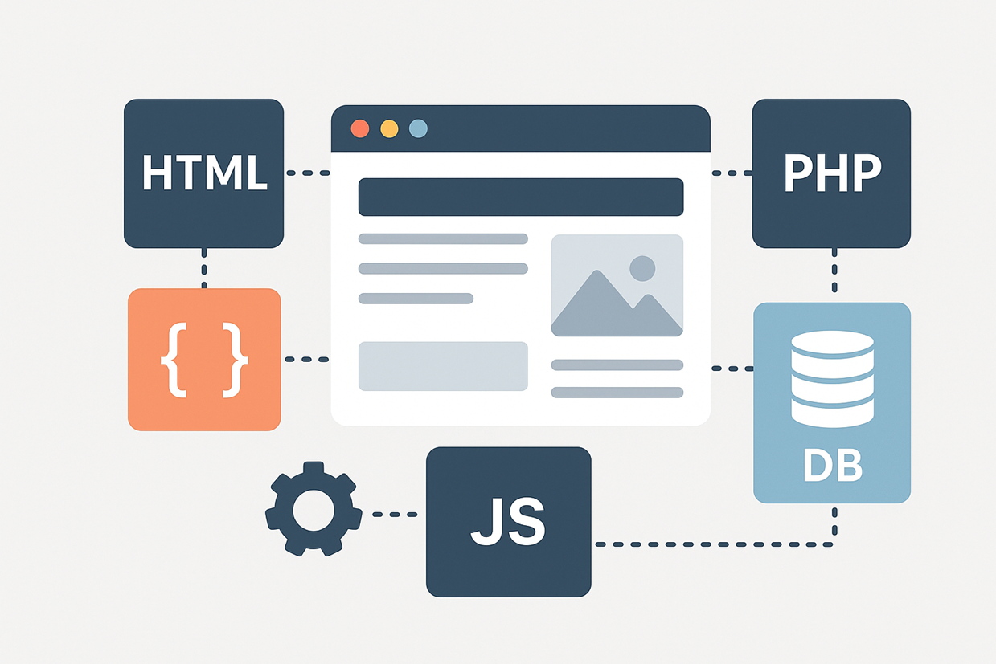
Design of the website

Slide 8
Languages used to create website
HTML: Defines the structure and content of the website.
CSS : Styles and formats the layout for a visually appealing design.
JavaScript: Adds interactivity and dynamic behavior to web pages.
PHP: Handles server-side processing, database connectivity, and backend logic.
MangoDB : exploring

Slide 9
Websites referring to learn
HTML & CSS: W3Schools
– Simple tutorials and hands-on examples.
JavaScript: JavaScript.info
– Clear explanations from basics to advanced concepts.
PHP: PHP Official Documentation
– Good reference plus examples, or TutorialsPoint PHP
for structured learning.
MongoDB: MongoDB University
– Free official courses with hands-on labs.

Slide 10
"We’re cooking up something special just for you. Coming soon—get ready!"
THANK YOU

